Slide 1

Green Leaf Nourish
Members: Keerthanaa E, Dave W, Tin N, Jahnavi G, Charan D, Ram G

Slide 2


Business Synopsis
Vegan Style Fast Food
Since 2021
Local Ingredients
Innovative Menu
Notes:
Our company is a vegan style fast food restaurant. Our first restaurant was established in 2021 and since then we have been expanding rapidly.
Our restaurant focuses on ingredient procured from local farmers as well as producers.
Our vision is to break away from traditional style Menu only, such as Burgers or sandwich, and introduce more innovative menus such as coconut Chia Pudding and Stir fried Tofu. We thrive in our innovative Menu, which is our top selling point.

Slide 3
Background and motivation
From traditional reporting style Excel to a digital database system
So, why is a database system helpful?
Notes:
GreenLeafNourish is a vegan style fast food restaurant. It’s a startup that was founded a couple of years ago. With healthy and tasty recipes to customer service, th e restaurant was growing rapidly. This startup has been using a traditional reporting style for maintaining its data. The traditional way includes Excel files to store information pertaining to the restaurant which includes inventory, customers, invoices, revenues, etc. There is only one problem with using Excel that is modification problems which means deleting, inserting, and updating records can be difficult and often prone to error. Modifying one cell can often misrepresent the other cell which later becomes a huge problem in the business.
We would like to introduce a digital transformation as in a Database system upon the request of the owner. According to an article from the chemical engineering department, it says that “People have been doing it for years using spreadsheets or standard historian-type software. What is different is that today's data analytics software solutions apply meaning to data, focus on key process indicators and encourage processors to use the data to find potentially impactful situations in advance” (LePree, 2023). Our project is to convert these manual files into an organized database. This Database has four components such as users, database applications, database management system and the database. DBMS has special tools like MySQL to manage the company’s database. These tools have functions like create tables, modify data, enforce rules, provide security and recovery which makes data transformation for the business more efficient and effective. Later on, we can use visualization tools such as Tableau to provide dashboards which provide a visual snapshot about the company.

Slide 4
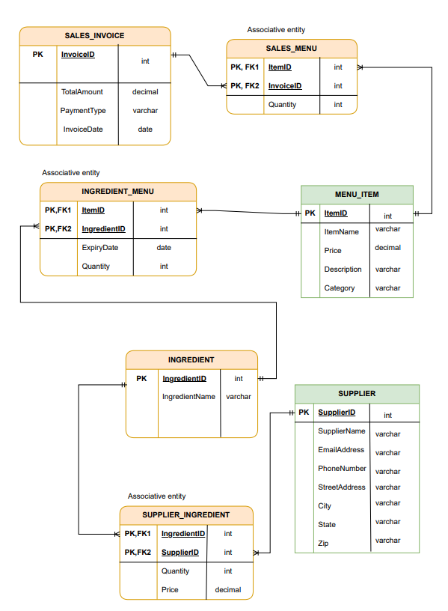
Entity Relationship Diagram
One to many relationships
PK
FK
Other attributes
Notes:
This is our design for the entity relationship diagram.
As you can see on the picture, it shows we have 4 main entities sales invoice, menu item, ingredient and supplier and we choose to have 3 associate entities , the sales menu, ingredients menu and supplier ingredient.
Initially we found it challenging to choose these entity, especially to make it realistic in real life setting, but eventually we settled with these 7.
we have connected the entities through a relationship.
For example . our sales invoice on the top left, can have multiple sales menu, but each sales menu can only belong to one sales invoice. So its a one to many relationship.
You may have realized that our design is rather linear once we introduced the associate entities. All of our connection are many to one relationship from the supplier to ingredients, all the way to sales invoice.
Each SALES_INVOICE can have multiple SALES_MENU, but each SALES_MENU belongs to only one SALES_INVOICE. So, it's a one-to-many relationship.
SALES_MENU - MENU_ITEM: Each SALES_MENU is associated with only one MENU_ITEM, but a MENU_ITEM can be associated with multiple SALES_MENU. So, it's a many-to-one relationship.
MENU_ITEM - INGREDIENT_MENU : A MENU_ITEM can be associated with multiple INGREDIENT_MENU items, but each INGREDIENT_MENU item is associated with only one MENU_ITEM. So, it's a one-to-many relationship.
INGREDIENT_MENU - INGREDIENT : An INGREDIENT_MENU can be associated with a single INGREDIENT items, but each INGREDIENT item is associated with multiple INGREDIENT_MENU. So, it's a one-to-many relationship.
INGREDIENT - SUPPLIER_INVENTORY: Each supplier inventory entry corresponds to only one INGREDIENT, but an INGREDIENT can have multiple SUPPLIER_INVENTORY items. So, it's a one-to-many relationship.
SUPPLIER_INVENTORY - SUPPLIER: Each SUPPLIER_INVENTORY entry corresponds to only one SUPPLIER, but a SUPPLIER can have multiple SUPPLIER_INVENTORY items. So, it's a one-to-many relationship.

Slide 5
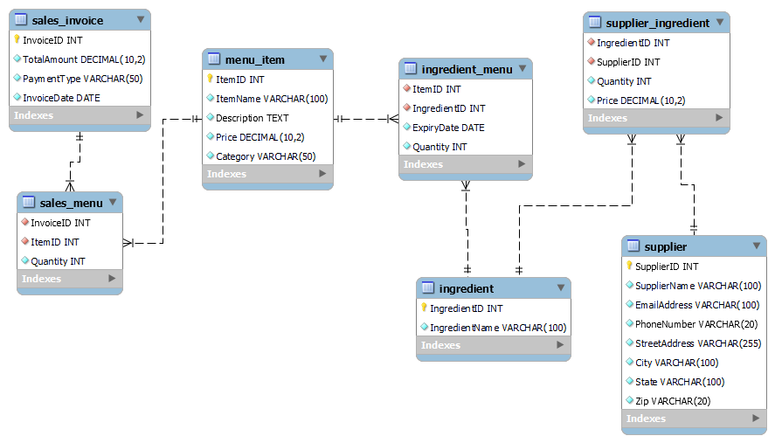
Data modelling and ER model
Notes:
What you see over here is similar to our initial design. This EER model is generated from MySQL program after we finish writing the sql script.
This diagram shows that our sql script works just the way we designed it. Here we see identical entities with their respective attributes and the different type of keys associated with the attributes.

Slide 6
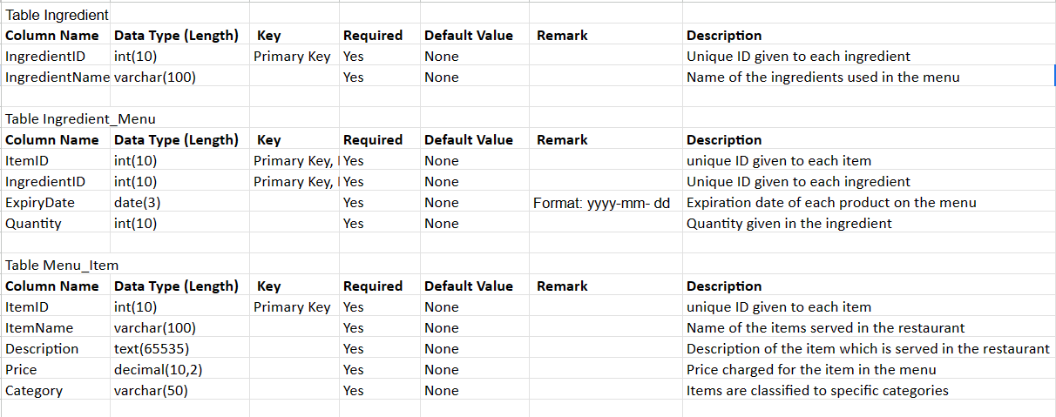
Data Dictionary
Notes:
Different tables and attributes associated with each of the table.
Data type is int, date, varchar depending on the column name.
PK, FK
Required means that data needs to be imputed in each field which is why we have not null.
You can set default value to anything you want but in our case we chose not to have it.
Remark: Is basically any note which needs to be known beforehand for easier understanding. For example: format of the date
Description: is why we chose to have these specific column names for the tables we have.

Slide 7
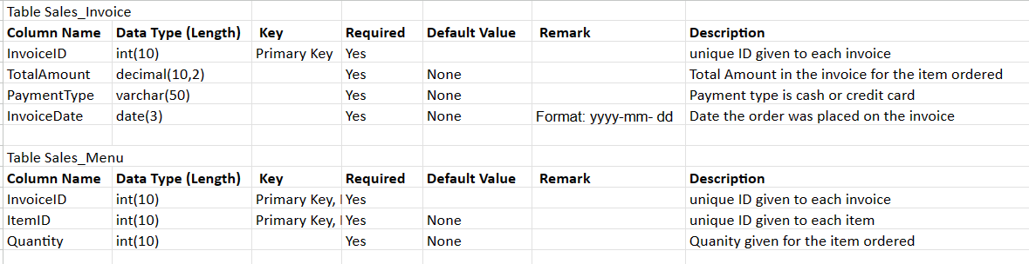
Data Dictionary

Slide 8
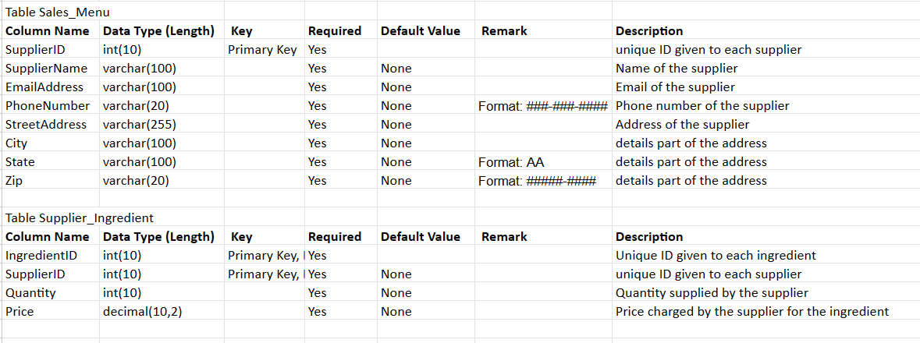
Data Dictionary

Slide 9
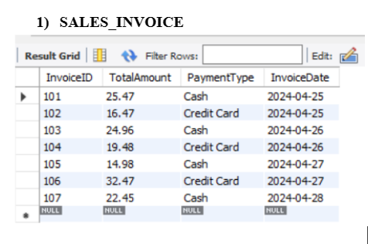
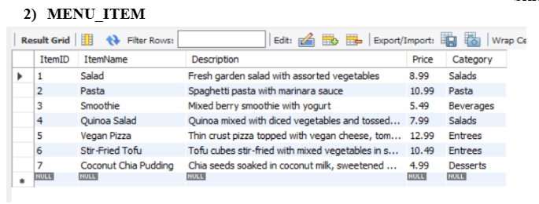
Database design

Slide 10
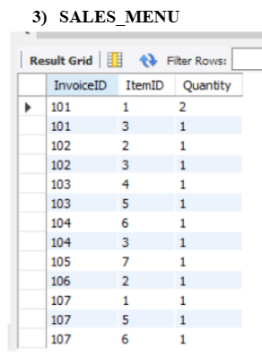
Database design

Slide 11
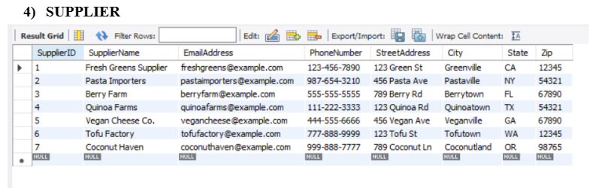
Database design

Slide 12
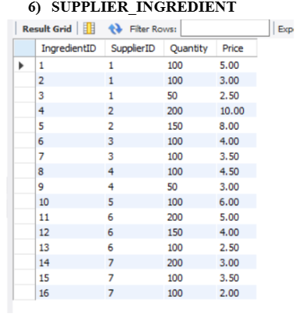
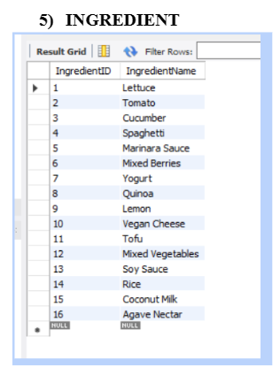
Database design

Slide 13
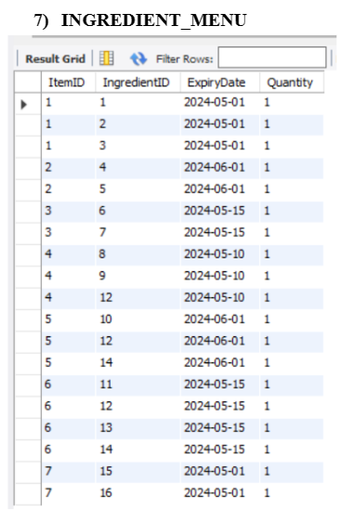
Database design

Slide 14
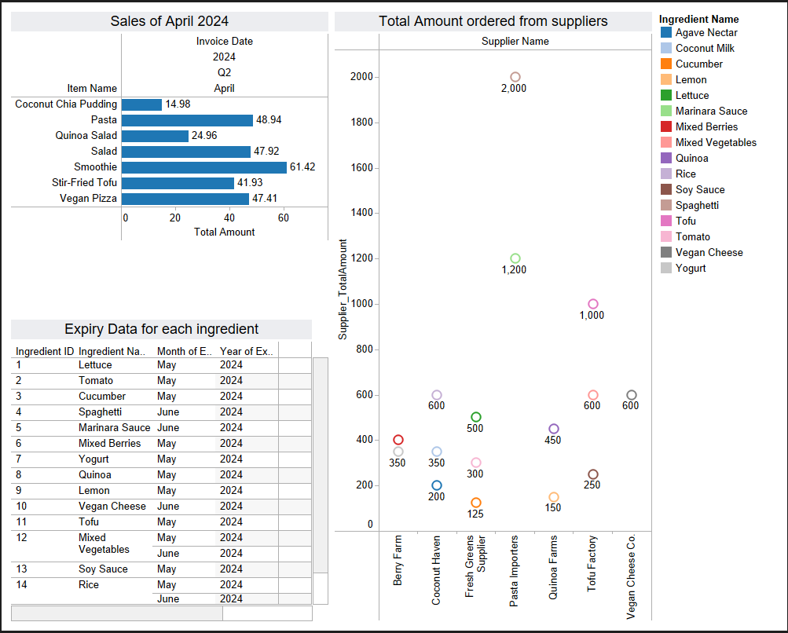
Tableau
Dashboard

Slide 15
Q & A

